Slide 1

[COVID-19 Waves] BMD-301 Project

Slide 2
Table of contents
01
Introduction
02
Problem definition & Purpose
03
04
Methodology
Results & Discussion
05
06
Conclusion
Future work & Suggestions

Slide 3
Introduction
We have depended on NCBI Covid-19 Database to extract the needed data.
using the multi-sequence alignment.
Used 20 samples with different Lineages.
In this project we were working on data for COVID-19 virus at different times in the US between Jan 2021 to May 2022, and compare between the covid sequence in these different waves. Additionally, we've applied the pairwise alignment between Covid-19 Spike protein with other Viral spike proteins.
Blast alignment to align the spike protein with other viral proteins.
Generating the phylogenetic tree with its visualization.
Finally, getting the most homologous protein and annotating it using NCBI and Uniprot.
Analysis of the followed steps by the Bash Script.

Slide 4

Problem definition & Purpose
In December 2019 in China Wuhan city, a new very speed virus appeared with a title COVID-19, then the disease spread until it became a pandemic and million of people got infected by it, and many countries went through different waves of COVID-19.
The majority of people who have coronavirus recover without needing special care. Others, however, are more likely to suffer from a serious illness. Our research into the treatment of different Coronavirus waves and the detection of SARS-CoV-2 infection is accomplished.

Slide 5
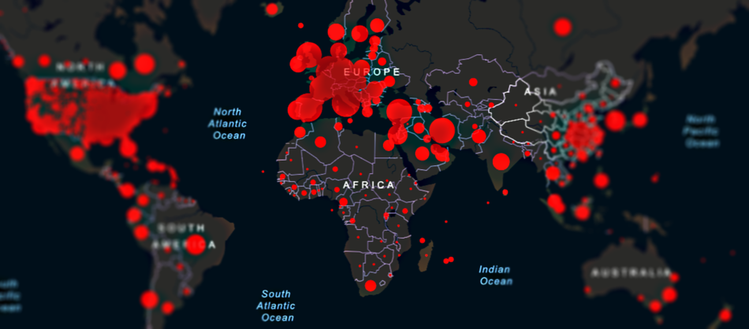
Spread of the COVID-19

Slide 6
—The main purpose of the project
To identify the rise in future waves and expect what will happen within these waves and how it could be effective
Identify the most homologs type of viral spike proteins with the covid spike protein.
That will help the ministry of health in each country to know the right or the correct way to protect their societies.

Slide 7
Methodology
Data Gathering
Blast
Multiple sequence Alignment
Homologs
Annotation
1
2
3
4
5
Extract the data from NCBI Covid-19 “USA” using 20 samples.
Multiple sequence alignment to generate the phylogenetic tree and visualizing it.
Comparison between covid-19 spike protein with other viral spike proteins to get the most homologs.
Find the most homologs protein.
Get more information about the spike protein we have.

Slide 8
Methodology
Data Gathering
Multiple Seq Alignment
Extracting the data from "NCBI Covid-19" and have chosen to work on the timeline of waves for the same country "United States" within different times using “20 samples" with different Lineage with "Fasta format". Used these downloaded data on the "Muscle Alignment" and make multiple sequence alignment (MSA) in order to generate "Phylogenetic Tree" and visualizing it.
Prepare the sequence in one file to apply the multiple sequence alignment in order to generate the phylogenetic tree to compare the covid-19 virus through the different waves and identify the development and the mutations in the virus with its new versions within the waves and detect the time that took for these changes.

Slide 9
Methodology
Blast
Homologs & Annotation
We worked on the spike protein that we have with the database “Pairwise Alignment” to find the most homologs spike and get its information.
We created a for loop to make the pairwise alignment along the database we use through using Blast.
Depended on both Bit scores & E-value to find the most homologs spike protein from the database with the samples of spike protein in Covid-19.
Determined the Cellular functional & Molecular function through searching for “Middle East Respiratory Syndrome” on NCBI, and Uniprot to find them.

Slide 10
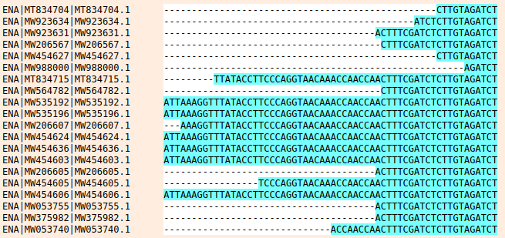
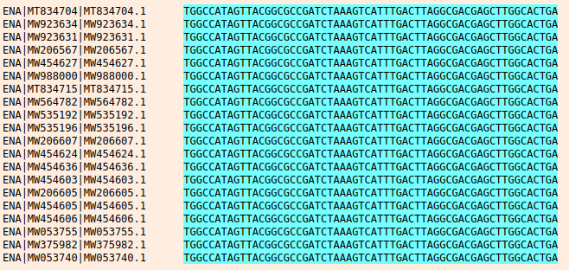
Results
After we extracted the data from "NCBI Covid-19“ which are "20 samples" with different Lineage with "fasta format", then performing multiple sequence alignment for our 20 samples using "Muscle Alignment".

Slide 11
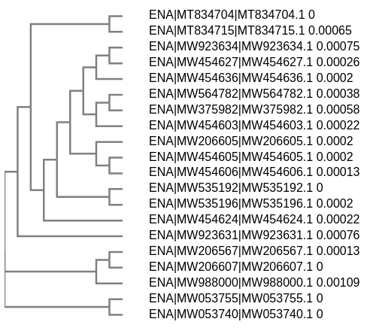
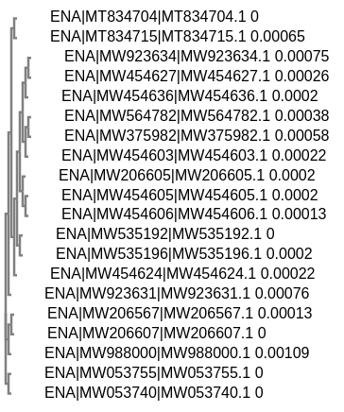
Results
Phylogenetic Tree Visualized

Slide 12
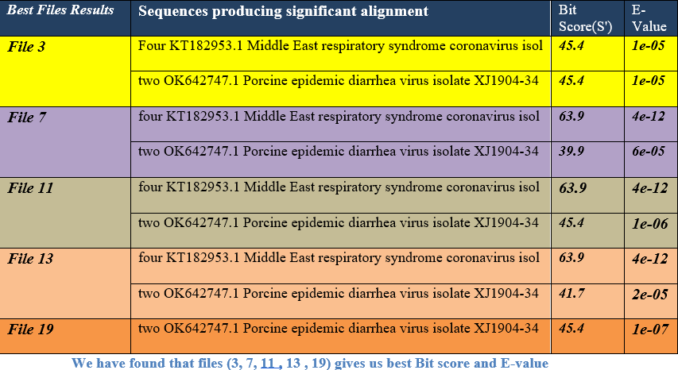
Results & Discussion
After we divided each blast file separately against the database, we were able to identify the gene that is most likely to result in recombination by performing the significant homologous search step. This step involves the alignment of two homologous sequences and the identification of the homologous site. So, we have chosen our most homologous gene based on the criteria of E-value, bit score, and the best coverage of each file.

Slide 13
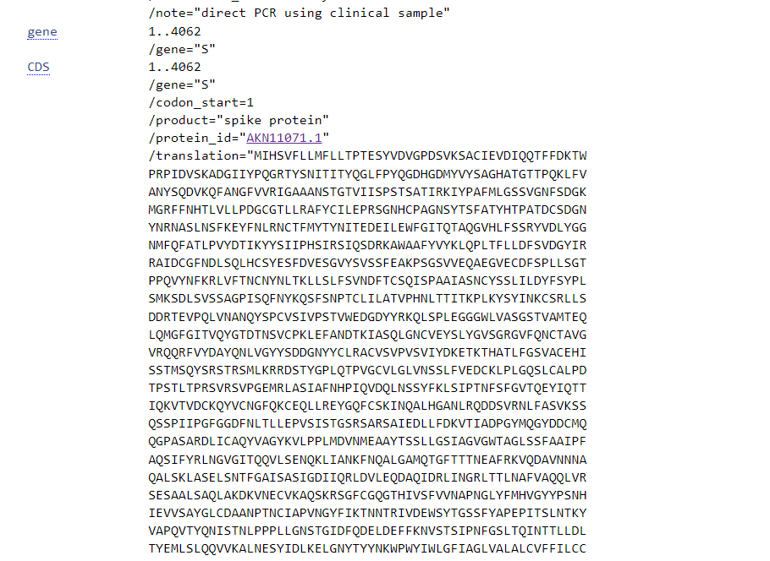
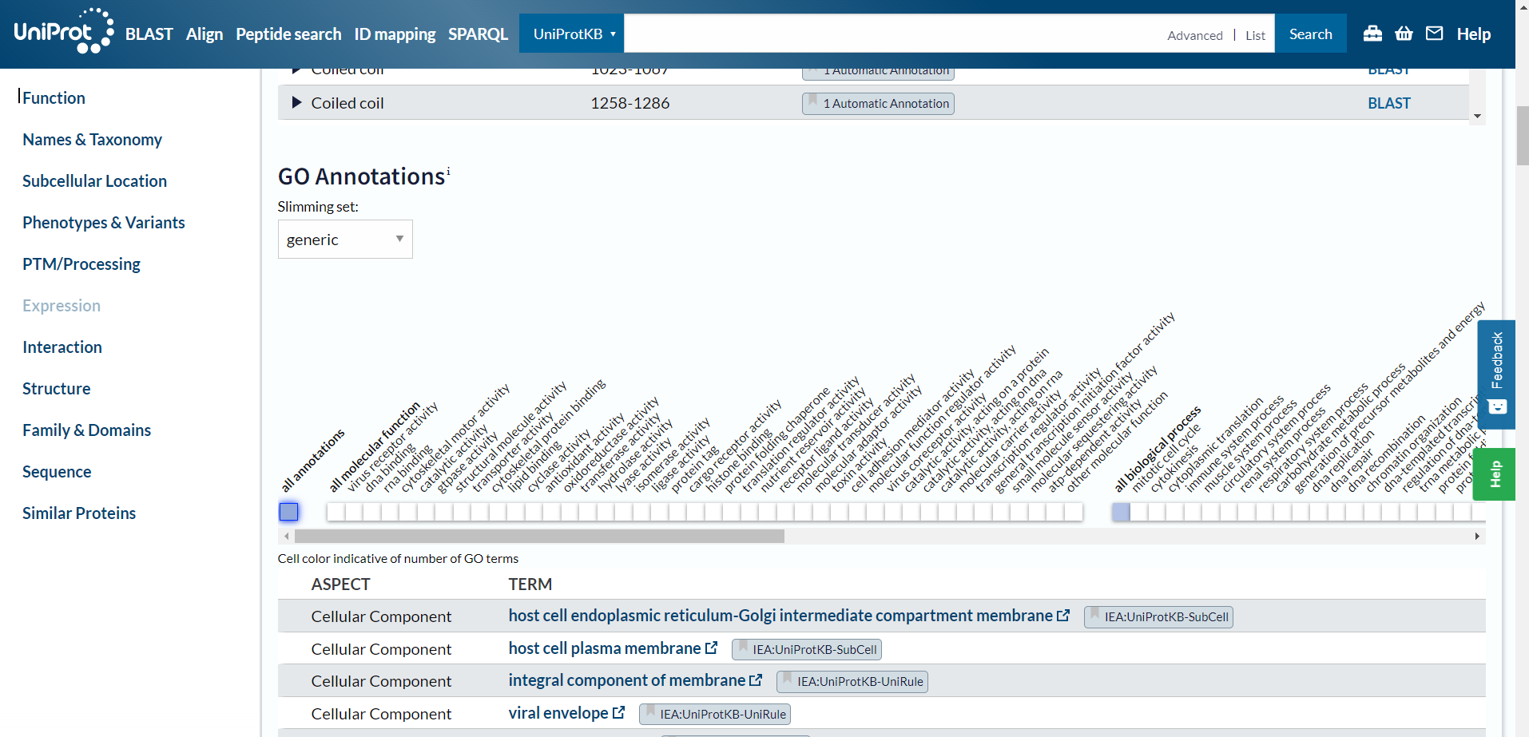
Results & Discussion
After we have chosen the most homologous gene based on the criteria upon E-value, bit score, coverage. Next, we searched for the gene in other databases and mentioned its cellular and molecular function and how it affects the disease.
So, we have chosen our best sequences which is:
• KT182953.1 Middle East respiratory syndrome coronavirus
After that, we used NCBI to get “Protein ID” and Uniport to mention in detail the function of the protein, gene ontology, cellular and molecular function and how it affects the disease.

Slide 14
Results & Discussion
Molecular Function
Molecular Function
How a Middle East respiratory syndrome coronavirus affects the Coronavirus Disease?
Cellular Function
Cellular Component
1
2
3
4
5
cell wall
Nucleus
nuclear envelope
Mitochondrion
Host cell membrane
Host membrane
Membrane
Viral envelope protein
Virion2
The virus's origins are not fully understood, but learn about the causes, symptoms, hazards, management, and prevention of Middle East respiratory syndrome, can assist us in the future in identifying the data on surveillance and for medical professionals.
lipid binding
cyclase activity
oxidoreductase activity
transferase activity
hydrolase activity
transducer activity
molecular adaptor activity
toxin activity
virus coreceptor activity
catalytic activity

Slide 15
Conclusion
In our project, significant differences between pandemic phases or waves were concluded by downloading COVID-19 database from NCBI database.
choosing the most homologous which is KT182953.1 Middle East respiratory syndrome coronavirus and annotating it using NCBI and Uniprot.
Performing multiple sequence alignment for our COVID-19 samples.
In addition, generating a phylogenetic tree and visualizing it.
Furthermore, Using BLAST to align COVID-19 spike protein with other viral spike proteins.
Generating COVID-19 sequences at different time points, which can help us later in understanding the evolution of infectious diseases.

Slide 16
Future work & Suggestions
In our future work, significant differences between pandemic phases or waves will be more discussed by downloading COVID-19 database from GISAID or NCBI database
Furthermore, working on the development of efficient and rapid sequencing methods to reconstruct the genomic sequence of SARS-CoV-2, the pathogenetic agent of COVID-19, as an essential part in the development of diagnostic molecular tests
Therefore, generating COVID-19 sequences at different time points can help us later in the evolution of infectious medical field.
As well as the development of effective measures and strategies to mitigate the pandemic's spread.

Slide 17
This work done by:
Manar Abdelrehim
Shrouk Hesham
Omnia Salah
Hussin Fekry
Seifelden Mohamed
Abdulrhman Mahmoud

Slide 18
Under Supervision of:
Dr. Mohamed El Hadidi
Eng. Manar Rashed
Eng. Eman Abdelrazik

Slide 19
Thanks, any Questions?

